Slide 1
Unify and Conquer Towards a Unified View of Machine Comprehension
Daniel Khashabi Allen Institute for AI, Seattle

Slide 2
Moving towards NLU, via QA

Slide 3

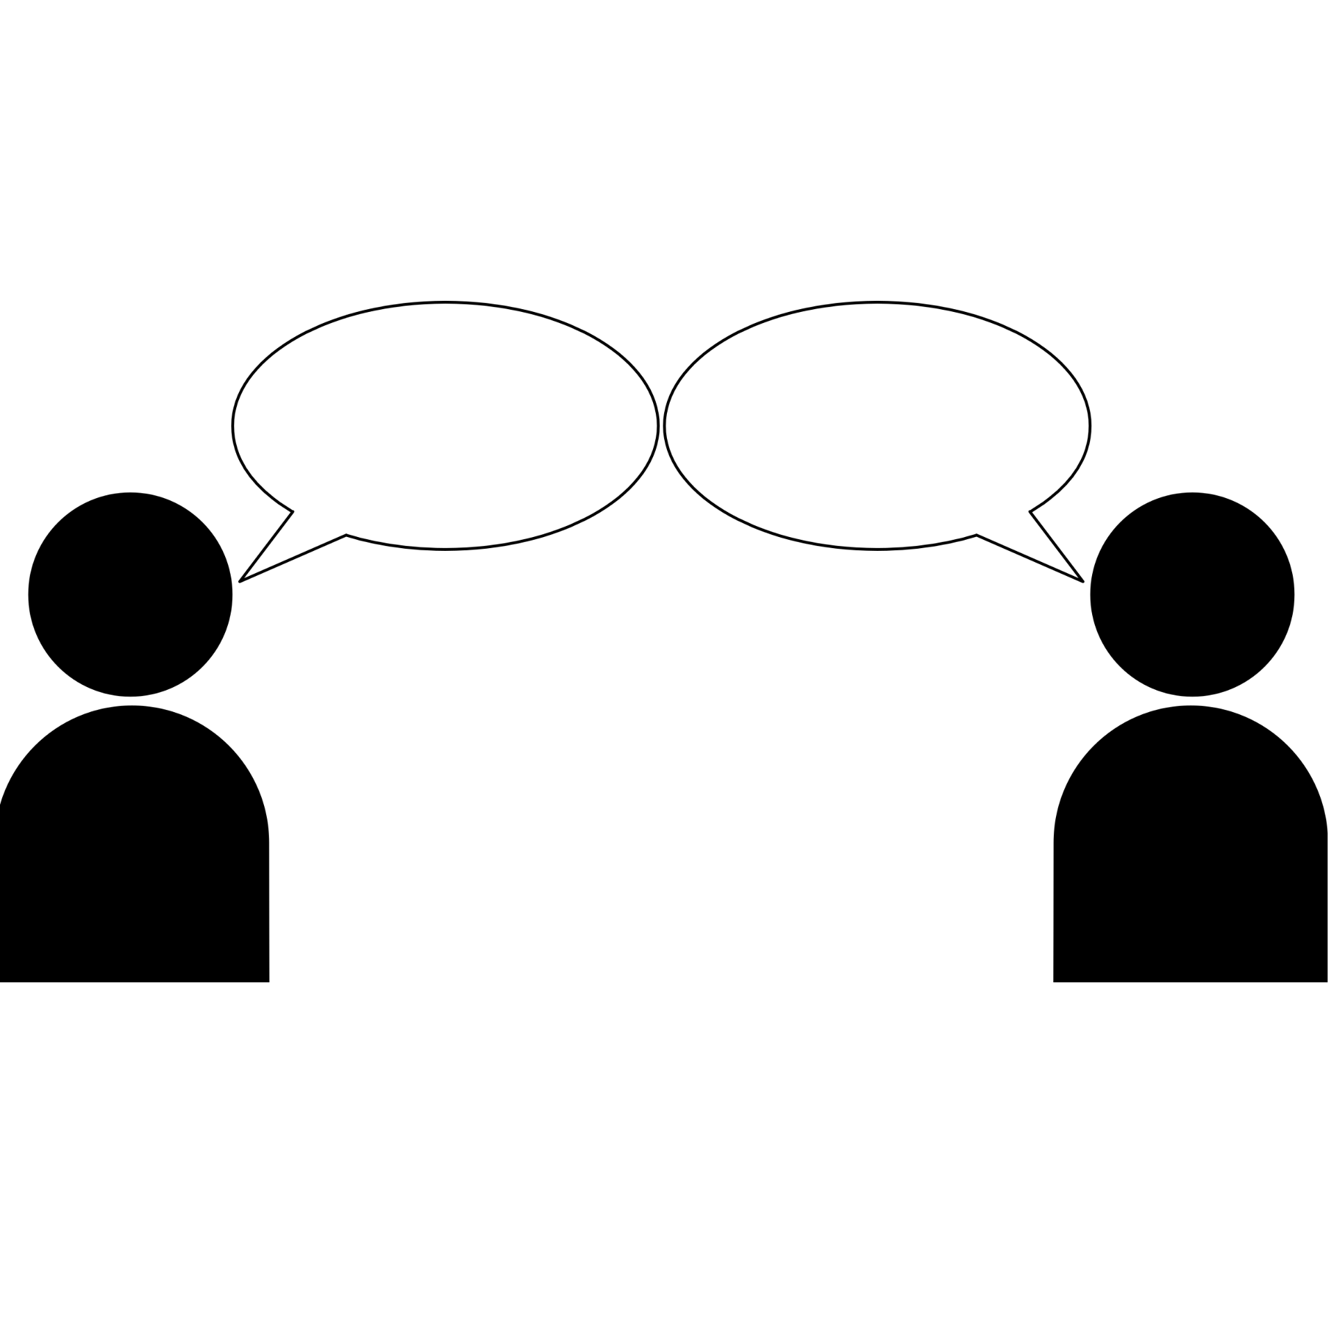
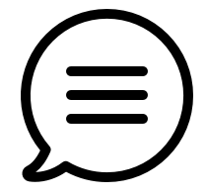
Moving towards NLU, via QA
Natural Language Understanding:
Interpret a given text similar to humans.
Measuring the progress by answering questions.
A system that is better in understanding language, should have a higher chance of answering these questions.
This has been used in the field for many years
Question Answering,
Reading Comprehension,
Machine Comprehension, etc.

Slide 4



Moving towards NLU, via QA
Natural Language Understanding:
Interpret a given text similar to humans.
Measuring the progress by answering questions.
A system that is better in understanding language, should have a higher chance of answering these questions.
This has been used in the field for many years
Question Answering,
Reading Comprehension,
Machine Comprehension, etc.
[Winograd, 1972; McCarthy 1976; Lehnert, 1977b; others]

Slide 5
Moving towards NLU, via QA
Natural Language Understanding:
Interpret a given text similar to humans.
Measuring the progress by answering questions.
A system that is better in understanding language, should have a higher chance of answering these questions.
This has been used in the field for many years
Question Answering,
Reading Comprehension,
Machine Comprehension, etc.
[Winograd, 1972; McCarthy 1976; Lehnert, 1977b; others]

Slide 6
QA; a broad definition
Task: Question Answering (QA)

Slide 7
QA; a broad definition
Task: Question Answering (QA)
“What does photosynthesis produce that helps plants grow?”

Slide 8
QA; a broad definition
Task: Question Answering (QA)
“What does photosynthesis produce that helps plants grow?”
Input: A question, along with additional information (hints, docs, images, etc.)

Slide 9
QA; a broad definition
Task: Question Answering (QA)
“What does photosynthesis produce that helps plants grow?”
Input: A question, along with additional information (hints, docs, images, etc.)

Slide 10
QA; a broad definition
Task: Question Answering (QA)
“What does photosynthesis produce that helps plants grow?”
Input: A question, along with additional information (hints, docs, images, etc.)

Slide 11
QA; a broad definition
Task: Question Answering (QA)
“What does photosynthesis produce that helps plants grow?”
“sugar”
Input: A question, along with additional information (hints, docs, images, etc.)
Output: a string that addresses the input question.

Slide 12
QA datasets
…
…
OBQA
BoolQ
NarQA
DROP
SQuAD1
SQuAD 2
ComQA
…
TREC-8
TREC-9
TREC-2001-2005.
MCTest
RACE
ARC
WinoGrande
2000 2005 2010 2015 2020

Slide 13
QA datasets
…
…
OBQA
BoolQ
Motivations for publishing new datasets:
Unexplored reasoning challenges
Alternate (better?) evaluation protocol (expand)
NarQA
DROP
SQuAD1
SQuAD 2
ComQA
…
TREC-8
TREC-9
TREC-2001-2005.
MCTest
RACE
ARC
WinoGrande
2000 2005 2010 2015 2020

Slide 14
QA datasets
…
…
OBQA
BoolQ
Motivations for publishing new datasets:
Unexplored reasoning challenges
Alternate (better?) evaluation protocol (expand)
NarQA
DROP
SQuAD1
SQuAD 2
ComQA
…
TREC-8
TREC-9
TREC-2001-2005.
MCTest
RACE
ARC
WinoGrande
2000 2005 2010 2015 2020

Slide 15
QA datasets
…
…
OBQA
BoolQ
Motivations for publishing new datasets:
Unexplored reasoning challenges
Alternate (better?) evaluation protocol (expand)
NarQA
DROP
SQuAD1
SQuAD 2
ComQA
…
TREC-8
TREC-9
TREC-2001-2005.
MCTest
RACE
ARC
WinoGrande
2000 2005 2010 2015 2020

Slide 16
QA datasets
…
OBQA
BoolQ
NarQA
DROP
SQuAD1
SQuAD 2
ComQA
…
TREC-8
TREC-9
TREC-2001-2005.
MCTest
RACE
ARC
WinoGrande
2000 2005 2010 2015 2020
[Rajpurkar et al, 2016]

Slide 17
QA datasets
…
OBQA
BoolQ
NarQA
DROP
SQuAD1
SQuAD 2
ComQA
…
TREC-8
TREC-9
TREC-2001-2005.
MCTest
RACE
ARC
WinoGrande
2000 2005 2010 2015 2020
Question: “At what speed did the turbine operate?”
[Rajpurkar et al, 2016]

Slide 18
QA datasets
…
OBQA
BoolQ
NarQA
DROP
SQuAD1
SQuAD 2
ComQA
…
TREC-8
TREC-9
TREC-2001-2005.
MCTest
RACE
ARC
WinoGrande
2000 2005 2010 2015 2020
Question: “At what speed did the turbine operate?”
Candidates: (Nikola_Tesla) On his 50th birthday in 1906, Tesla demonstrated his 200 horsepower (150 kilowatts) 16,000 rpm bladeless turbine. ...
[Rajpurkar et al, 2016]

Slide 19
QA datasets
…
OBQA
BoolQ
NarQA
DROP
SQuAD1
SQuAD 2
ComQA
…
TREC-8
TREC-9
TREC-2001-2005.
MCTest
RACE
ARC
WinoGrande
2000 2005 2010 2015 2020
Question: “At what speed did the turbine operate?”
Candidates: (Nikola_Tesla) On his 50th birthday in 1906, Tesla demonstrated his 200 horsepower (150 kilowatts) 16,000 rpm bladeless turbine. ...
[Rajpurkar et al, 2016]

Slide 20
QA datasets
…
OBQA
BoolQ
NarQA
DROP
SQuAD1
SQuAD 2
ComQA
…
TREC-8
TREC-9
TREC-2001-2005.
MCTest
RACE
ARC
WinoGrande
2000 2005 2010 2015 2020
Question: “At what speed did the turbine operate?”
“16,000 rpm”
Candidates: (Nikola_Tesla) On his 50th birthday in 1906, Tesla demonstrated his 200 horsepower (150 kilowatts) 16,000 rpm bladeless turbine. ...
[Rajpurkar et al, 2016]

Slide 21
QA datasets
…
OBQA
BoolQ
NarQA
DROP
SQuAD1
SQuAD 2
ComQA
…
TREC-8
TREC-9
TREC-2001-2005.
MCTest
RACE
ARC
WinoGrande
2000 2005 2010 2015 2020
[Clark et al, 2018]

Slide 22
QA datasets
…
OBQA
BoolQ
NarQA
DROP
SQuAD1
SQuAD 2
ComQA
…
TREC-8
TREC-9
TREC-2001-2005.
MCTest
RACE
ARC
WinoGrande
2000 2005 2010 2015 2020
Question: “What does photosynthesis produce that helps plants grow? ”
[Clark et al, 2018]

Slide 23
QA datasets
…
OBQA
BoolQ
NarQA
DROP
SQuAD1
SQuAD 2
ComQA
…
TREC-8
TREC-9
TREC-2001-2005.
MCTest
RACE
ARC
WinoGrande
2000 2005 2010 2015 2020
Question: “What does photosynthesis produce that helps plants grow? ”
Candidates: (A) water (B) oxygen (C) protein (D) sugar
[Clark et al, 2018]

Slide 24
QA datasets
…
OBQA
BoolQ
NarQA
DROP
SQuAD1
SQuAD 2
ComQA
…
TREC-8
TREC-9
TREC-2001-2005.
MCTest
RACE
ARC
WinoGrande
2000 2005 2010 2015 2020
Question: “What does photosynthesis produce that helps plants grow? ”
Candidates: (A) water (B) oxygen (C) protein (D) sugar
[Clark et al, 2018]

Slide 25
QA datasets
…
OBQA
BoolQ
NarQA
DROP
SQuAD1
SQuAD 2
ComQA
…
TREC-8
TREC-9
TREC-2001-2005.
MCTest
RACE
ARC
WinoGrande
2000 2005 2010 2015 2020
Question: “What does photosynthesis produce that helps plants grow? ”
“The big kid”
Candidates: (A) water (B) oxygen (C) protein (D) sugar
[Clark et al, 2018]

Slide 26
QA Terminology

Slide 27
QA Terminology
“Task”: well-formed response for a well-formed question.
“Format”: QA with particular assumptions about input/output.
Defined by datasets.
A necessity for automatic evaluation.
Depends on the reasoning problem, too.
Input: well-formed question
Output: a well-formed response

Slide 28
QA Terminology
“Task”: well-formed response for a well-formed question.
“Format”: QA with particular assumptions about input/output.
Defined by datasets.
A necessity for automatic evaluation.
Depends on the reasoning problem, too.
Input: well-formed question
Output: a well-formed response

Slide 29
QA Terminology
“Task”: well-formed response for a well-formed question.
“Format”: QA with particular assumptions about input/output.
Defined by datasets.
A necessity for automatic evaluation.
Depends on the reasoning problem, too.
Input: well-formed question
Output: a well-formed response
Format | Example dataset
Multiple-choice | CommonsenseQA [Talmor et al’19]
YesNo | BoolQ [Clark et al’19]
extractive | SQuAD [Rajpurkar et al’16]
abstractive | NarrativeQA [Kociský et al’18]

Slide 30
QA Terminology
“Task”: well-formed response for a well-formed question.
“Format”: QA with particular assumptions about input/output.
Defined by datasets.
A necessity for automatic evaluation.
Depends on the reasoning problem, too.
Input: well-formed question
Output: a well-formed response
Format | Example dataset
Multiple-choice | CommonsenseQA [Talmor et al’19]
YesNo | BoolQ [Clark et al’19]
extractive | SQuAD [Rajpurkar et al’16]
abstractive | NarrativeQA [Kociský et al’18]

Slide 31
Our progress in QA: the good
More general language representations.

Slide 32
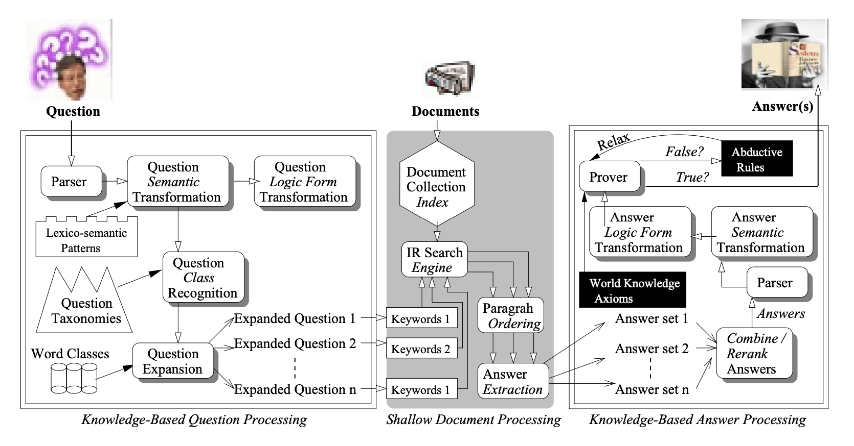
Our progress in QA: the good
More general language representations.
[Harabagiu et al, 2000; others]

Slide 33
Our progress in QA: the good
More general language representations.
[Harabagiu et al, 2000; others]
Input
Task-specific layer
[Peters et al; Devlin et al; others]

Slide 34
Our progress in QA: the bad
Input
Task-specific layer

Slide 35
Our progress in QA: the bad
Input
Task-specific layer
Task-specific assumptions

Slide 36
Our progress in QA: the bad
Input
Task-specific layer
format | assumption
Yes/No QA
Multiple-choice QA
Extractive QA
Abstractive QA
Task-specific assumptions

Slide 37
Our progress in QA: the bad
Input
Task-specific layer
format | assumption
Yes/No QA
Multiple-choice QA
Extractive QA
Abstractive QA
binary output
Task-specific assumptions

Slide 38
Our progress in QA: the bad
Input
Task-specific layer
format | assumption
Yes/No QA
Multiple-choice QA
Extractive QA
Abstractive QA
binary output
exactly one of the candidate answers is correct.
Task-specific assumptions

Slide 39
Our progress in QA: the bad
Input
Task-specific layer
format | assumption
Yes/No QA
Multiple-choice QA
Extractive QA
Abstractive QA
binary output
exactly one of the candidate answers is correct.
answer is a subset of a given paragraph
Task-specific assumptions

Slide 40
Our progress in QA: the bad
Input
Task-specific layer
format | assumption
Yes/No QA
Multiple-choice QA
Extractive QA
Abstractive QA
binary output
exactly one of the candidate answers is correct.
answer is a subset of a given paragraph
answer is a mixture of what is given and items not given.
Task-specific assumptions

Slide 41
Our progress in QA: the bad
Consequences of format-specific design:
Prevent generalization across formats
Don’t benefit from labeled data of other formats.
Input
Task-specific layer
format | assumption
Yes/No QA
Multiple-choice QA
Extractive QA
Abstractive QA
binary output
exactly one of the candidate answers is correct.
answer is a subset of a given paragraph
answer is a mixture of what is given and items not given.
Task-specific assumptions

Slide 42
Our progress in QA: the bad
Consequences of format-specific design:
Prevent generalization across formats
Don’t benefit from labeled data of other formats.
Input
Task-specific layer
format | assumption
Yes/No QA
Multiple-choice QA
Extractive QA
Abstractive QA
binary output
exactly one of the candidate answers is correct.
answer is a subset of a given paragraph
answer is a mixture of what is given and items not given.
Task-specific assumptions

Slide 43
Our progress in QA: the bad
Consequences of format-specific design:
Prevent generalization across formats
Don’t benefit from labeled data of other formats.
Input
Task-specific layer
format | assumption
Yes/No QA
Multiple-choice QA
Extractive QA
Abstractive QA
binary output
exactly one of the candidate answers is correct.
answer is a subset of a given paragraph
answer is a mixture of what is given and items not given.
Task-specific assumptions

Slide 44
formats-specialized models
ExtractiveQA
MultipleChoiceQA

Slide 45
formats-specialized models
ExtractiveQA
Question: “At what speed did the turbine operate?”
(Nikola_Tesla) On his 50th birthday in 1906, Tesla demonstrated his 200 horsepower (150 kilowatts) 16,000 rpm bladeless turbine. …
“16,000 rpm”
MultipleChoiceQA

Slide 46
formats-specialized models
ExtractiveQA
Question: “At what speed did the turbine operate?”
(Nikola_Tesla) On his 50th birthday in 1906, Tesla demonstrated his 200 horsepower (150 kilowatts) 16,000 rpm bladeless turbine. …
“16,000 rpm”
MultipleChoiceQA
Question: “What does photosynthesis produce that helps plants grow?”
(A) water (B) oxygen (C) protein (D) sugar
“sugar”

Slide 47
formats-specialized models
ExtractiveQA
Question: “At what speed did the turbine operate?”
(Nikola_Tesla) On his 50th birthday in 1906, Tesla demonstrated his 200 horsepower (150 kilowatts) 16,000 rpm bladeless turbine. …
“16,000 rpm”
MultipleChoiceQA
Question: “What does photosynthesis produce that helps plants grow?”
(A) water (B) oxygen (C) protein (D) sugar
“sugar”

Slide 48
formats-specialized models
ExtractiveQA
Question: “At what speed did the turbine operate?”
(Nikola_Tesla) On his 50th birthday in 1906, Tesla demonstrated his 200 horsepower (150 kilowatts) 16,000 rpm bladeless turbine. …
“16,000 rpm”
MultipleChoiceQA
Question: “What does photosynthesis produce that helps plants grow?”
(A) water (B) oxygen (C) protein (D) sugar
“sugar”

Slide 49
formats-specialized models
ExtractiveQA
Question: “At what speed did the turbine operate?”
(Nikola_Tesla) On his 50th birthday in 1906, Tesla demonstrated his 200 horsepower (150 kilowatts) 16,000 rpm bladeless turbine. …
“16,000 rpm”
MultipleChoiceQA
Question: “What does photosynthesis produce that helps plants grow?”
(A) water (B) oxygen (C) protein (D) sugar
“sugar”

Slide 50
formats-specialized models
ExtractiveQA
Question: “At what speed did the turbine operate?”
(Nikola_Tesla) On his 50th birthday in 1906, Tesla demonstrated his 200 horsepower (150 kilowatts) 16,000 rpm bladeless turbine. …
“16,000 rpm”
MultipleChoiceQA
Question: “What does photosynthesis produce that helps plants grow?”
(A) water (B) oxygen (C) protein (D) sugar
“sugar”

Slide 51
Beyond formats-specialized models
ExtractiveQA
Question: “At what speed did the turbine operate?”
(Nikola_Tesla) On his 50th birthday in 1906, Tesla demonstrated his 200 horsepower (150 kilowatts) 16,000 rpm bladeless turbine. …
“16,000 rpm”
MultipleChoiceQA
Question: “What does photosynthesis produce that helps plants grow?”
(A) water (B) oxygen (C) protein (D) sugar
“sugar”

Slide 52
Beyond formats-specialized models
ExtractiveQA
Question: “At what speed did the turbine operate?”
(Nikola_Tesla) On his 50th birthday in 1906, Tesla demonstrated his 200 horsepower (150 kilowatts) 16,000 rpm bladeless turbine. …
“16,000 rpm”
MultipleChoiceQA
Question: “What does photosynthesis produce that helps plants grow?”
(A) water (B) oxygen (C) protein (D) sugar
“sugar”

Slide 53
Beyond formats-specialized models
ExtractiveQA
Question: “At what speed did the turbine operate?”
(Nikola_Tesla) On his 50th birthday in 1906, Tesla demonstrated his 200 horsepower (150 kilowatts) 16,000 rpm bladeless turbine. …
“16,000 rpm”
MultipleChoiceQA
Question: “What does photosynthesis produce that helps plants grow?”
(A) water (B) oxygen (C) protein (D) sugar
“sugar”

Slide 54
Beyond formats-specialized models
ExtractiveQA
Question: “At what speed did the turbine operate?”
(Nikola_Tesla) On his 50th birthday in 1906, Tesla demonstrated his 200 horsepower (150 kilowatts) 16,000 rpm bladeless turbine. …
“16,000 rpm”
MultipleChoiceQA
Question: “What does photosynthesis produce that helps plants grow?”
(A) water (B) oxygen (C) protein (D) sugar
“sugar”

Slide 55
Talk Summary & Statement

Slide 56
Talk Summary & Statement
Creating format-specific QA models distance us from broad QA.
There is overlap between underlying reasoning abilities of formats.
One can benefit from mixing QA formats.
UnifiedQA: a single QA system working across four common QA formats.
Fine-tuning models pre-trained on UnifiedQA yields SOTA results.

Slide 57
Talk Summary & Statement
Creating format-specific QA models distance us from broad QA.
There is overlap between underlying reasoning abilities of formats.
One can benefit from mixing QA formats.
UnifiedQA: a single QA system working across four common QA formats.
Fine-tuning models pre-trained on UnifiedQA yields SOTA results.

Slide 58
Talk Summary & Statement
Creating format-specific QA models distance us from broad QA.
There is overlap between underlying reasoning abilities of formats.
One can benefit from mixing QA formats.
UnifiedQA: a single QA system working across four common QA formats.
Fine-tuning models pre-trained on UnifiedQA yields SOTA results.

Slide 59
Earlier work on multi-task learning

Slide 60
Earlier work on multi-task learning
In the same spirit as multi-task learning.
The choice of tasks is also important.
Earlier works select too broad of tasks.
E.g., Raffel et al’19 diverse NLP tasks (machine translation, summarization, etc) and conclude that a single model for multiple NLP tasks underperform task-specific models.
We narrow the scope of tasks to stay within the boundaries of QA.
No task/format specific encoding.
[Caruana'97; McCann et al’18]

Slide 61
Earlier work on multi-task learning
In the same spirit as multi-task learning.
The choice of tasks is also important.
Earlier works select too broad of tasks.
E.g., Raffel et al’19 diverse NLP tasks (machine translation, summarization, etc) and conclude that a single model for multiple NLP tasks underperform task-specific models.
We narrow the scope of tasks to stay within the boundaries of QA.
No task/format specific encoding.
[Caruana'97; McCann et al’18]
Didn’t work before; why would it work now? 🤔

Slide 62
Earlier work on multi-task learning
In the same spirit as multi-task learning.
The choice of tasks is also important.
Earlier works select too broad of tasks.
E.g., Raffel et al’19 diverse NLP tasks (machine translation, summarization, etc) and conclude that a single model for multiple NLP tasks underperform task-specific models.
We narrow the scope of tasks to stay within the boundaries of QA.
No task/format specific encoding.
[Caruana'97; McCann et al’18]
Didn’t work before; why would it work now? 🤔

Slide 63
Earlier work on multi-task learning
In the same spirit as multi-task learning.
The choice of tasks is also important.
Earlier works select too broad of tasks.
E.g., Raffel et al’19 diverse NLP tasks (machine translation, summarization, etc) and conclude that a single model for multiple NLP tasks underperform task-specific models.
We narrow the scope of tasks to stay within the boundaries of QA.
No task/format specific encoding.
[Caruana'97; McCann et al’18]
Didn’t work before; why would it work now? 🤔

Slide 64
Earlier work on multi-task learning
In the same spirit as multi-task learning.
The choice of tasks is also important.
Earlier works select too broad of tasks.
E.g., Raffel et al’19 diverse NLP tasks (machine translation, summarization, etc) and conclude that a single model for multiple NLP tasks underperform task-specific models.
We narrow the scope of tasks to stay within the boundaries of QA.
No task/format specific encoding.
[Caruana'97; McCann et al’18]
Didn’t work before; why would it work now? 🤔

Slide 65
Earlier work on multi-task learning
In the same spirit as multi-task learning.
The choice of tasks is also important.
Earlier works select too broad of tasks.
E.g., Raffel et al’19 diverse NLP tasks (machine translation, summarization, etc) and conclude that a single model for multiple NLP tasks underperform task-specific models.
We narrow the scope of tasks to stay within the boundaries of QA.
No task/format specific encoding.
[Caruana'97; McCann et al’18]
Didn’t work before; why would it work now? 🤔

Slide 66
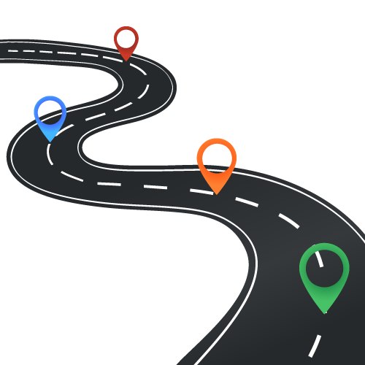
Roadmap
Generalization across formats
UnifiedQA + Empirical Intuitions
Discussion and next steps

Slide 67
Roadmap
Generalization across formats
UnifiedQA + Empirical Intuitions
Discussion and next steps

Slide 68
UnifiedQA: a high-level definition

Slide 69
UnifiedQA: a high-level definition
It’s a single system that is supposed to work on a variety of QA formats.
The input should be natural.
Minimal-enough for a human solver to infer the format.

Slide 70
UnifiedQA: a high-level definition
It’s a single system that is supposed to work on a variety of QA formats.
The input should be natural.
Minimal-enough for a human solver to infer the format.

Slide 71
UnifiedQA: a high-level definition
It’s a single system that is supposed to work on a variety of QA formats.
The input should be natural.
Minimal-enough for a human solver to infer the format.
“What causes sound?
(A) sunlight (B) vibrations (C) x-rays (D) pitch”

Slide 72
UnifiedQA: a high-level definition
It’s a single system that is supposed to work on a variety of QA formats.
The input should be natural.
Minimal-enough for a human solver to infer the format.
“What causes sound?
(A) sunlight (B) vibrations (C) x-rays (D) pitch”
“vibrations”

Slide 73
UnifiedQA: a high-level definition
It’s a single system that is supposed to work on a variety of QA formats.
The input should be natural.
Minimal-enough for a human solver to infer the format.
“Is Jamaica considered part of the United States?
(Jamaica) Jamaica (/dʒəˈmeɪkə/ ( listen)) is an island country situated in the Caribbean Sea. Spanning 10,990 square kilometres (4,240 sq mi) in area, it is the third-largest island of the Greater Antilles and the fourth-largest island country in the Caribbean.”

Slide 74
UnifiedQA: a high-level definition
It’s a single system that is supposed to work on a variety of QA formats.
The input should be natural.
Minimal-enough for a human solver to infer the format.
“Is Jamaica considered part of the United States?
(Jamaica) Jamaica (/dʒəˈmeɪkə/ ( listen)) is an island country situated in the Caribbean Sea. Spanning 10,990 square kilometres (4,240 sq mi) in area, it is the third-largest island of the Greater Antilles and the fourth-largest island country in the Caribbean.”
“no”

Slide 75
UnifiedQA: a high-level definition
It’s a single system that is supposed to work on a variety of QA formats.
The input should be natural.
Minimal-enough for a human solver to infer the format.
“What type of musical instruments did the Yuan bring to China?
(Yuan_dynasty) Western musical instruments were introduced to enrich Chinese performing arts. From this period dates the conversion to Islam, by Muslims of Central Asia, of growing numbers of Chinese in the northwest and southwest. ...”

Slide 76
UnifiedQA: a high-level definition
It’s a single system that is supposed to work on a variety of QA formats.
The input should be natural.
Minimal-enough for a human solver to infer the format.
“What type of musical instruments did the Yuan bring to China?
(Yuan_dynasty) Western musical instruments were introduced to enrich Chinese performing arts. From this period dates the conversion to Islam, by Muslims of Central Asia, of growing numbers of Chinese in the northwest and southwest. ...”
“Western musical instruments”

Slide 77
UnifiedQA: a high-level definition
It’s a single system that is supposed to work on a variety of QA formats.
The input should be natural.
Minimal-enough for a human solver to infer the format.
The question always comes first.
Additional info are appended with “\n”.
“What type of musical instruments did the Yuan bring to China?
(Yuan_dynasty) Western musical instruments were introduced to enrich Chinese performing arts. From this period dates the conversion to Islam, by Muslims of Central Asia, of growing numbers of Chinese in the northwest and southwest. ...”
“Western musical instruments”

Slide 78
UnifiedQA: towards an implementation

Slide 79
UnifiedQA: towards an implementation
Use text-to-text architectures
T5 [Raffal et al, 2020], BART [Lewis et al, 2019], etc.
Train simultaneously on all datasets jointly together.
Batches contains the same number of instances from each training set.

Slide 80
UnifiedQA: towards an implementation
Use text-to-text architectures
T5 [Raffal et al, 2020], BART [Lewis et al, 2019], etc.
Train simultaneously on all datasets jointly together.
Batches contains the same number of instances from each training set.

Slide 81
UnifiedQA: towards an implementation
Use text-to-text architectures
T5 [Raffal et al, 2020], BART [Lewis et al, 2019], etc.
Train simultaneously on all datasets jointly together.
Batches contains the same number of instances from each training set.

Slide 82
Mixing pairs of formats: experiment (1)
Is there any value in out-of-format training?
69.4
62.5
59.1
55.8

Slide 83
Mixing pairs of formats: experiment (1)
Is there any value in out-of-format training?
Mixing RACE (Multiple-Choice) w/ datasets of different formats.
69.4
62.5
59.1
55.8

Slide 84
Mixing pairs of formats: experiment (1)
Is there any value in out-of-format training?
70
65
60
55
50
Mixing RACE (Multiple-Choice) w/ datasets of different formats.
69.4
62.5
59.1
Trained on RACE
55.8
RACE
MCTest
[Lai et al. 17]
[Richardson et al. 15]

Slide 85
Mixing pairs of formats: experiment (1)
Is there any value in out-of-format training?
70
65
60
55
50
Mixing RACE (Multiple-Choice) w/ datasets of different formats.
69.4
62.5
59.1
Trained on RACE
55.8
RACE
MCTest
[Lai et al. 17]
[Richardson et al. 15]

Slide 86
Mixing pairs of formats: experiment (1)
Is there any value in out-of-format training?
70
65
60
55
50
Mixing RACE (Multiple-Choice) w/ datasets of different formats.
69.4
62.5
59.1
Trained on RACE
55.8
Trained on RACE + SQuAD 1
RACE
MCTest
[Lai et al. 17]
[Richardson et al. 15]

Slide 87
Mixing pairs of formats: experiment (1)
Is there any value in out-of-format training?
70
65
60
55
50
Mixing RACE (Multiple-Choice) w/ datasets of different formats.
69.4
62.5
59.1
Trained on RACE
55.8
Trained on RACE + SQuAD 1
RACE
MCTest
[Lai et al. 17]
[Richardson et al. 15]

Slide 88
Mixing pairs of formats: experiment (1)
Is there any value in out-of-format training?
70
65
60
55
50
Mixing RACE (Multiple-Choice) w/ datasets of different formats.
69.4
62.5
59.1
Trained on RACE
55.8
Trained on RACE + SQuAD 1
RACE
MCTest
[Lai et al. 17]
[Richardson et al. 15]

Slide 89
Mixing pairs of formats: experiment (2)
Is there any value in out-of-format training?
Mixing BoolQ (YesNo) w/ datasets of different formats.
80
70
60
50
X=SQuAD 1 (Extractive)
78.9
76.4
X=SQuAD 1 (Extractive)
66.0
X=NarQA (Abstractive)
64.1
Trained on BoolQ
61.0
53.4
Trained on BoolQ + X
BoolQ
BoolQ-CS
MultiRC (YN subset)
[Clark et al. 19] [Gardner et al. 20] [K et al. 18]

Slide 90
Mixing pairs of formats: experiment (2)
Is there any value in out-of-format training?
Mixing BoolQ (YesNo) w/ datasets of different formats.
80
70
60
50
X=SQuAD 1 (Extractive)
78.9
76.4
X=SQuAD 1 (Extractive)
66.0
X=NarQA (Abstractive)
64.1
Trained on BoolQ
61.0
53.4
Trained on BoolQ + X
BoolQ
BoolQ-CS
MultiRC (YN subset)
[Clark et al. 19] [Gardner et al. 20] [K et al. 18]

Slide 91
Mixing pairs of formats: experiment (2)
Is there any value in out-of-format training?
Mixing BoolQ (YesNo) w/ datasets of different formats.
80
70
60
50
X=SQuAD 1 (Extractive)
78.9
76.4
X=SQuAD 1 (Extractive)
66.0
X=NarQA (Abstractive)
64.1
Trained on BoolQ
61.0
53.4
Trained on BoolQ + X
BoolQ
BoolQ-CS
MultiRC (YN subset)
[Clark et al. 19] [Gardner et al. 20] [K et al. 18]

Slide 92
Mixing pairs of formats: experiment (2)
Is there any value in out-of-format training?
Mixing BoolQ (YesNo) w/ datasets of different formats.
80
70
60
50
X=SQuAD 1 (Extractive)
78.9
76.4
X=SQuAD 1 (Extractive)
66.0
X=NarQA (Abstractive)
64.1
Trained on BoolQ
61.0
53.4
Trained on BoolQ + X
BoolQ
BoolQ-CS
MultiRC (YN subset)
[Clark et al. 19] [Gardner et al. 20] [K et al. 18]

Slide 93
Mixing pairs of formats: experiment (2)
Is there any value in out-of-format training?
Mixing BoolQ (YesNo) w/ datasets of different formats.
80
70
60
50
X=SQuAD 1 (Extractive)
78.9
76.4
X=SQuAD 1 (Extractive)
66.0
X=NarQA (Abstractive)
64.1
Trained on BoolQ
61.0
53.4
Trained on BoolQ + X
BoolQ
BoolQ-CS
MultiRC (YN subset)
[Clark et al. 19] [Gardner et al. 20] [K et al. 18]

Slide 94
Mixing pairs of formats: experiment (2)
Is there any value in out-of-format training?
Mixing BoolQ (YesNo) w/ datasets of different formats.
80
70
60
50
X=SQuAD 1 (Extractive)
78.9
76.4
X=SQuAD 1 (Extractive)
66.0
X=NarQA (Abstractive)
64.1
Trained on BoolQ
61.0
53.4
Trained on BoolQ + X
BoolQ
BoolQ-CS
MultiRC (YN subset)
[Clark et al. 19] [Gardner et al. 20] [K et al. 18]

Slide 95
Mixing pairs of formats: experiment (2)
Is there any value in out-of-format training?
Mixing BoolQ (YesNo) w/ datasets of different formats.
80
70
60
50
X=SQuAD 1 (Extractive)
78.9
76.4
X=SQuAD 1 (Extractive)
66.0
X=NarQA (Abstractive)
64.1
Trained on BoolQ
61.0
53.4
Trained on BoolQ + X
BoolQ
BoolQ-CS
MultiRC (YN subset)
[Clark et al. 19] [Gardner et al. 20] [K et al. 18]

Slide 96
Roadmap
Generalization across formats
UnifiedQA + Empirical Intuitions
Discussion and next steps

Slide 97
Roadmap
Generalization across formats
UnifiedQA + Empirical Intuitions
Discussion and next steps

Slide 98
UnifiedQA-v1

Slide 99
UnifiedQA-v1
Trained on the union of different formats:
Extractive: SQuAD 1.1, SQuAD 2.0
Abstractive: NarrativeQA
Multiple-choice: RACE, ARC, OBQA, MCTest
YesNo: BoolQ
Architectures:
T5 (11B, 3B, …)
BART (large)

Slide 100
UnifiedQA-v1
Trained on the union of different formats:
Extractive: SQuAD 1.1, SQuAD 2.0
Abstractive: NarrativeQA
Multiple-choice: RACE, ARC, OBQA, MCTest
YesNo: BoolQ
Architectures:
T5 (11B, 3B, …)
BART (large)
https://github.com/allenai/unifiedqa

Slide 101
Intuition #1: Comparison w/ Dedicated Models

Slide 102
Intuition #1: Comparison w/ Dedicated Models

Slide 103
Intuition #1: Comparison w/ Dedicated Models
Is UnifiedQA as good as systems dedicated to individual datasets?
UnifiedQA performs almost as good as individual T5 models targeted to each dataset.

Slide 104
Intuition #1: Comparison w/ Dedicated Models
Is UnifiedQA as good as systems dedicated to individual datasets?
UnifiedQA performs almost as good as individual T5 models targeted to each dataset.
evaluation sets
 | SQuAD2 | RACE | BoolQ | NarQA
T5 (SQuAD 2) | 91 | 33 | 12 | 51
T5 (RACE) | 43 | 87 | 7 | 54
T5 (BoolQ) | 4 | 22 | 90 | 0
T5 (NarQA) | 45 | 48 | 47 | 65
UnifiedQA | 90 | 87 | 90 | 65

Slide 105
Intuition #2: Unseen Datasets

Slide 106
Intuition #2: Unseen Datasets
evaluation sets
 | NewsQA | Quoref | DROP | DROP-CS | QASC | CommonsenseQA | NP-BoolQ | BoolQ-CS | Avg
UnifiedQA [EX] | 59 | 65 | 25 | 24 | 55 | 63 | 21 | 13 | 42
UnifiedQA [AB] | 58 | 68 | 31 | 37 | 54 | 59 | 27 | 40 | 48
UnifiedQA [MC] | 48 | 68 | 29 | 37 | 68 | 76 | 3 | 6 | 44
UnifiedQA [YN] | 1 | 2 | 0 | 0 | 15 | 21 | 79 | 79 | 22
UnifiedQA | 59 | 63 | 33 | 40 | 68 | 76 | 81 | 80 | 62
models trained for individual formats

Slide 107
Intuition #2: Unseen Datasets
Does UnifiedQA generalizes well to unseen datasets?
On average, UnifiedQA shows much stronger generalization across a wide range of datasets.
evaluation sets
 | NewsQA | Quoref | DROP | DROP-CS | QASC | CommonsenseQA | NP-BoolQ | BoolQ-CS | Avg
UnifiedQA [EX] | 59 | 65 | 25 | 24 | 55 | 63 | 21 | 13 | 42
UnifiedQA [AB] | 58 | 68 | 31 | 37 | 54 | 59 | 27 | 40 | 48
UnifiedQA [MC] | 48 | 68 | 29 | 37 | 68 | 76 | 3 | 6 | 44
UnifiedQA [YN] | 1 | 2 | 0 | 0 | 15 | 21 | 79 | 79 | 22
UnifiedQA | 59 | 63 | 33 | 40 | 68 | 76 | 81 | 80 | 62
models trained for individual formats

Slide 108
Fine-tuning on UnifiedQA
Is there a value in using UnifiedQA as a starting point for fine-tuning?
Show SOTA on 10 datasets (OBQA, QASC, RACE, WinoGrande, PIQA, SIQA, ROPES)
Similar trends for BART
85
75
65
87
84
78
79
Fine-tuned on T5
78
70
Fine-tuned UnifiedQA (based on T5)
ARC-chall
CommonsenseQA
OBQA
[Clark et al. 18] [Talmor et al. 19] [Khot et al. 19]

Slide 109
Fine-tuning on UnifiedQA
Is there a value in using UnifiedQA as a starting point for fine-tuning?
Show SOTA on 10 datasets (OBQA, QASC, RACE, WinoGrande, PIQA, SIQA, ROPES)
Similar trends for BART
85
75
65
87
84
78
79
Fine-tuned on T5
78
70
Fine-tuned UnifiedQA (based on T5)
ARC-chall
CommonsenseQA
OBQA
[Clark et al. 18] [Talmor et al. 19] [Khot et al. 19]

Slide 110
Fine-tuning on UnifiedQA
Is there a value in using UnifiedQA as a starting point for fine-tuning?
Show SOTA on 10 datasets (OBQA, QASC, RACE, WinoGrande, PIQA, SIQA, ROPES)
Similar trends for BART
85
75
65
87
84
78
79
Fine-tuned on T5
78
70
Fine-tuned UnifiedQA (based on T5)
ARC-chall
CommonsenseQA
OBQA
[Clark et al. 18] [Talmor et al. 19] [Khot et al. 19]

Slide 111
Demo
https://unifiedqa.apps.allenai.org

Slide 112
Roadmap
Generalization across formats
UnifiedQA + Empirical Intuitions
Discussion and next steps

Slide 113
Roadmap
Generalization across formats
UnifiedQA + Empirical Intuitions
Discussion and next steps

Slide 114
Methodological Issue: Data Leakage

Slide 115
Methodological Issue: Data Leakage
“have you done some studies on overlap across datasets?”
Easy answer:
not much surface-form overlap between the datasets.
Nuanced/ difficult answer:
more data (especially during pre-training) increases the chances of (indirect) leakage.

Slide 116
Methodological Issue: Data Leakage
“have you done some studies on overlap across datasets?”
Easy answer:
not much surface-form overlap between the datasets.
Nuanced/ difficult answer:
more data (especially during pre-training) increases the chances of (indirect) leakage.

Slide 117
Where do we go from here?

Slide 118
Where do we go from here?
More formats
Can we incorporate other “natural” variations of QA in the study?
Smaller models:
Can we build small and accurate models to make it more available?
Beyond QA/Text:
Can you take these ideas and apply it to some other problems?

Slide 119
Where do we go from here?
More formats
Can we incorporate other “natural” variations of QA in the study?
Smaller models:
Can we build small and accurate models to make it more available?
Beyond QA/Text:
Can you take these ideas and apply it to some other problems?

Slide 120
Where do we go from here?
More formats
Can we incorporate other “natural” variations of QA in the study?
Smaller models:
Can we build small and accurate models to make it more available?
Beyond QA/Text:
Can you take these ideas and apply it to some other problems?

Slide 121
Take-home points
The field relies excessively format-specific assumptions for system design.
Instead, we should move towards more general QA architectures.
Incentive: there is value in mixing QA datasets of different formats.
UnifiedQA, a single pre-trained QA system seeking to bring unification across common QA formats.
https://github.com/allenai/unifiedqa

